Slide 1


Hello!
IT professions
Prepared by:
Petrochenko Kirill
Nikolaev Michael
In the field of Information Technology (IT), there are numerous professions, all of which are essential. Today, we'll highlight a few of these most important ones.

Slide 2

Support Specialists
IT professions
In the field of Information Technology (IT), there are numerous professions, all of which are essential. Today, we'll highlight a few of these most important ones.
Analyze and troubleshoot computer network and equipment issues, ensuring smooth operation of IT systems.

Slide 3

Computer Programmer
Support Specialists
Analyze and troubleshoot computer network and equipment issues, ensuring smooth operation of IT systems.
Their primary responsibility is to analyse and troubleshoot problems with computer networks and equipment

Slide 4

Quality assurance tester
Computer Programmer
Their primary responsibility is to analyse and troubleshoot problems with computer networks and equipment
Test and evaluate software products to ensure functionality, reliability, and quality, detecting and reporting any defects.

Slide 5

Web Developer
Quality assurance tester
Test and evaluate software products to ensure functionality, reliability, and quality, detecting and reporting any defects.
Design websites using coding languages, crafting user-friendly and visually appealing web experiences.

Slide 6

IT Technician
Web Developer
Design websites using coding languages, crafting user-friendly and visually appealing web experiences.
Analyze and diagnose computer issues, provide technical support, and train employees on new programs and functions for efficient IT operations.

Slide 7
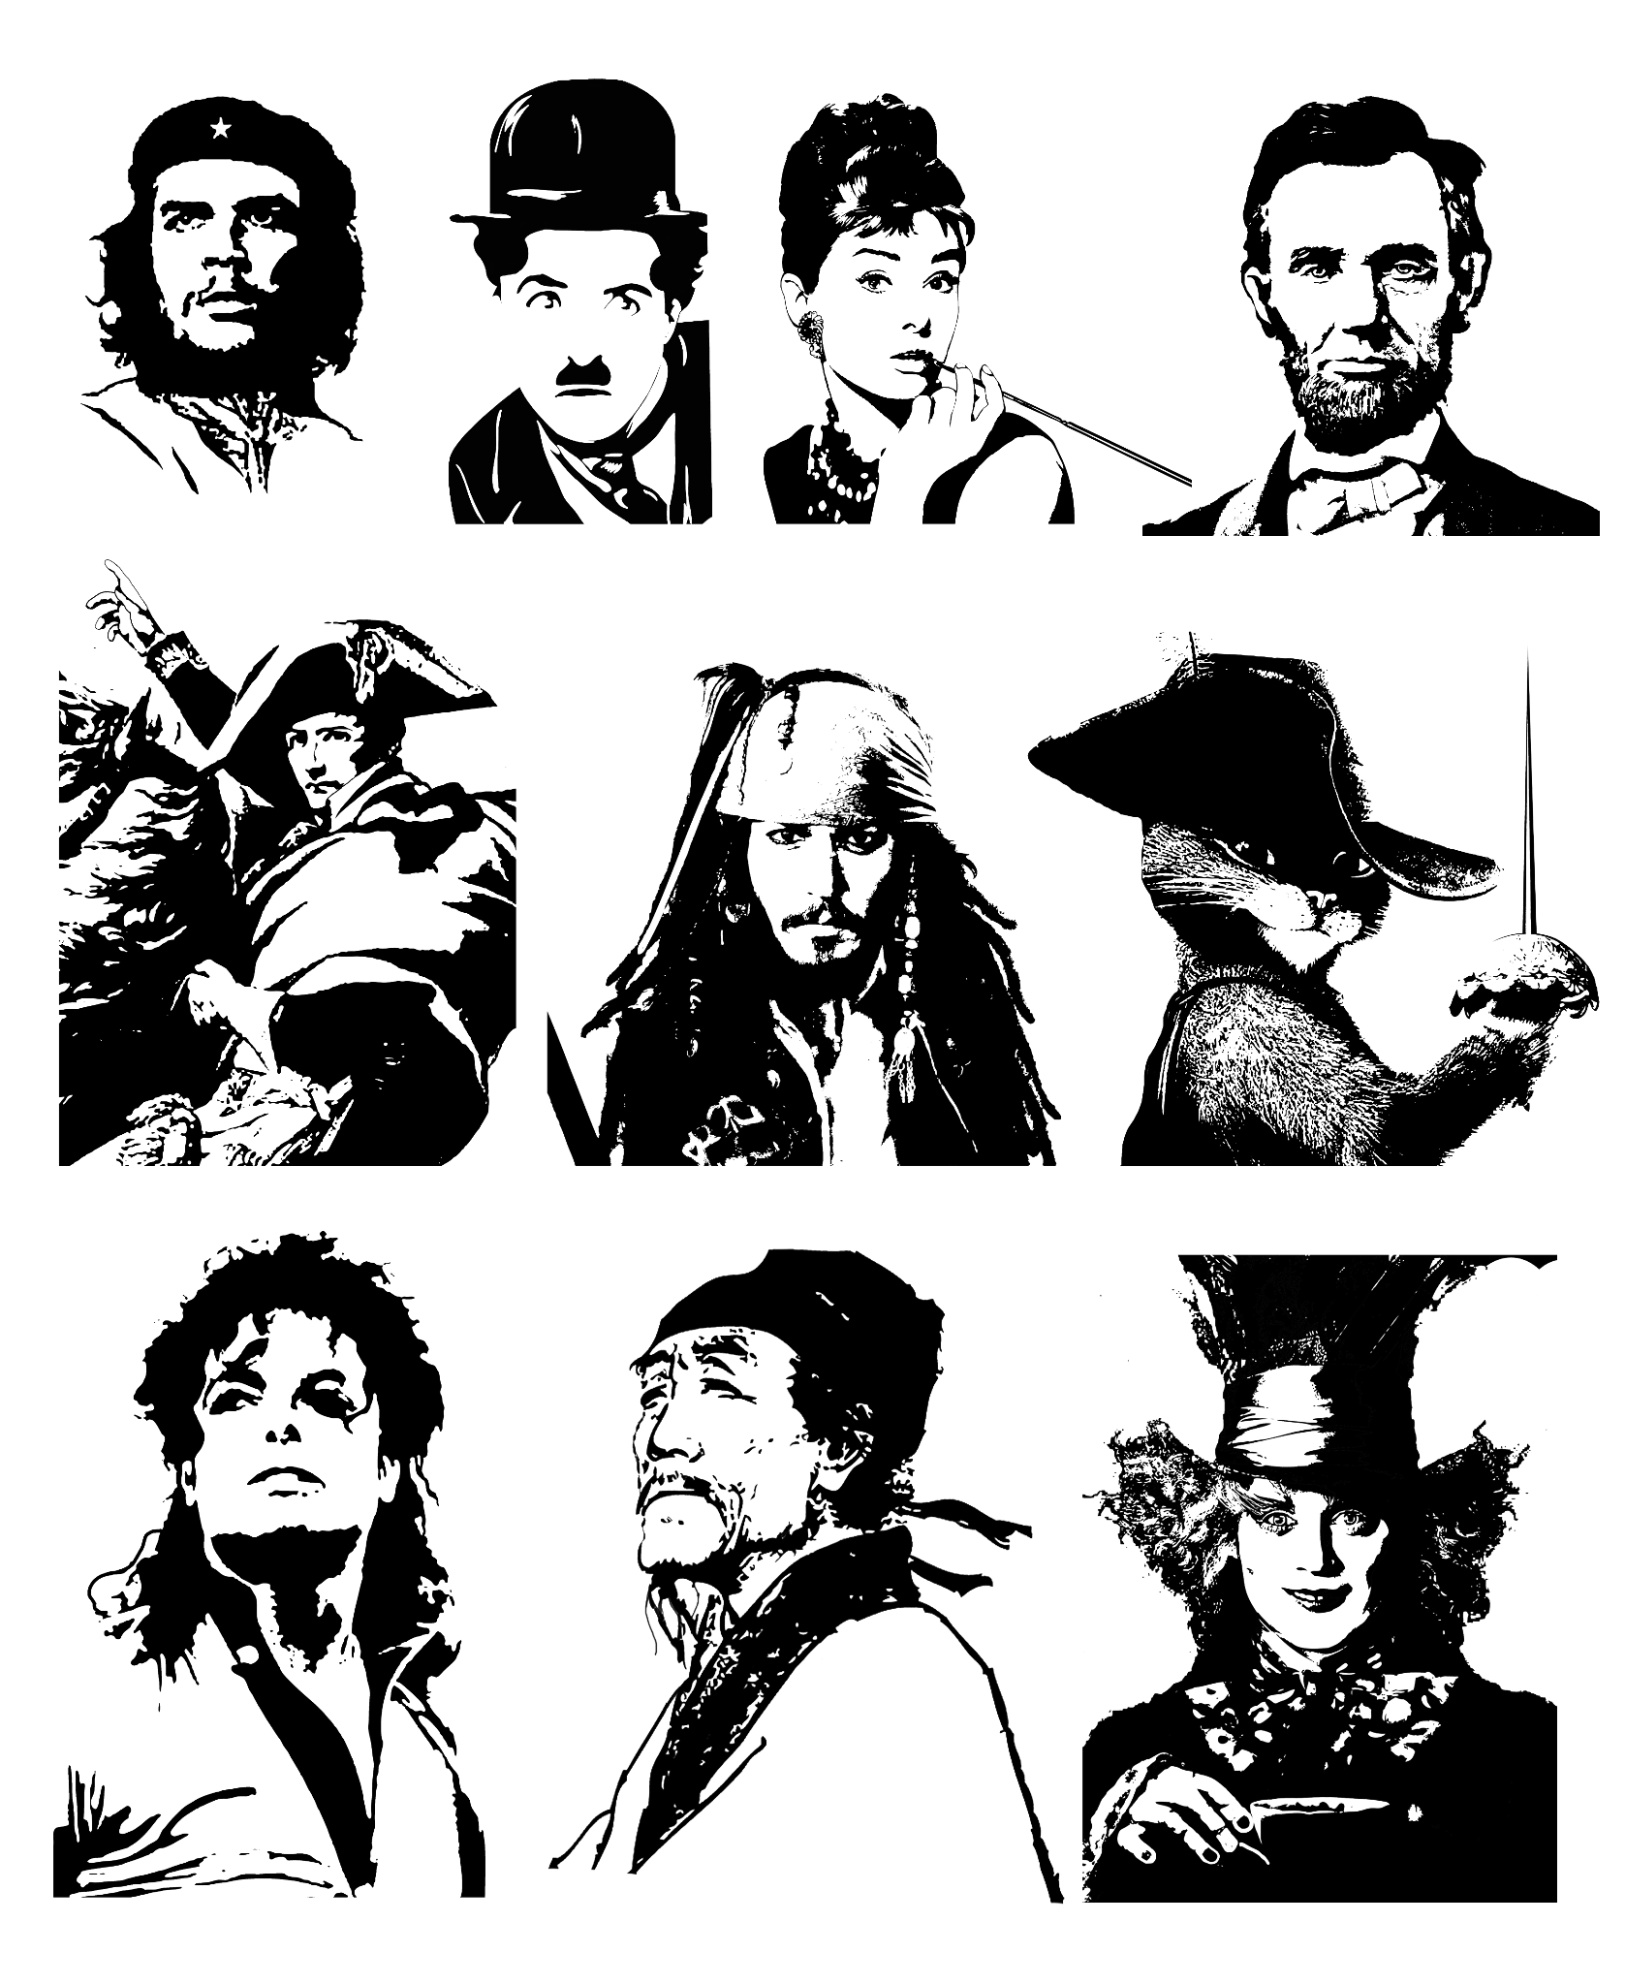
Famous personalities
IT Technician
Analyze and diagnose computer issues, provide technical support, and train employees on new programs and functions for efficient IT operations.
Many well-known figures have made significant contributions to the IT industry. Today, we'll share stories about a few of them.

Slide 8
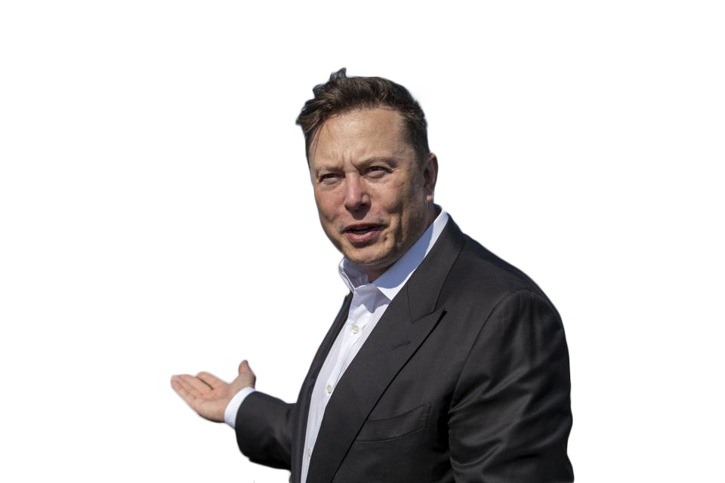
Elon Musk
Famous personalities
Founder of SpaceX, Tesla, Neuralink, and The Boring Company.
Renowned for his groundbreaking work in electric vehicles (Tesla), space exploration (SpaceX), and neural technology (Neuralink). Musk's vision and innovation have reshaped multiple industries, pushing the boundaries of technology and sustainability.
Many well-known figures have made significant contributions to the IT industry. Today, we'll share stories about a few of them.

Slide 9
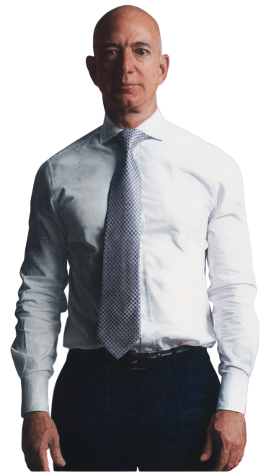
Jeff Bezos
Elon Musk
Founder of Amazon and owner of Blue Origin.
Bezos revolutionized e-commerce through Amazon, creating one of the world's largest and most influential companies. His passion for space exploration has driven Blue Origin's pursuit of commercial space travel, promising to open new frontiers in the space industry.
Founder of SpaceX, Tesla, Neuralink, and The Boring Company.
Renowned for his groundbreaking work in electric vehicles (Tesla), space exploration (SpaceX), and neural technology (Neuralink). Musk's vision and innovation have reshaped multiple industries, pushing the boundaries of technology and sustainability.

Slide 10
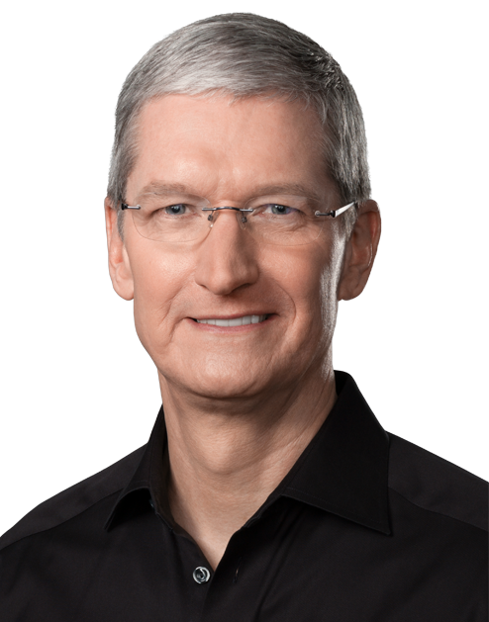
Jeff Bezos
Founder of Amazon and owner of Blue Origin.
Bezos revolutionized e-commerce through Amazon, creating one of the world's largest and most influential companies. His passion for space exploration has driven Blue Origin's pursuit of commercial space travel, promising to open new frontiers in the space industry.

Slide 11
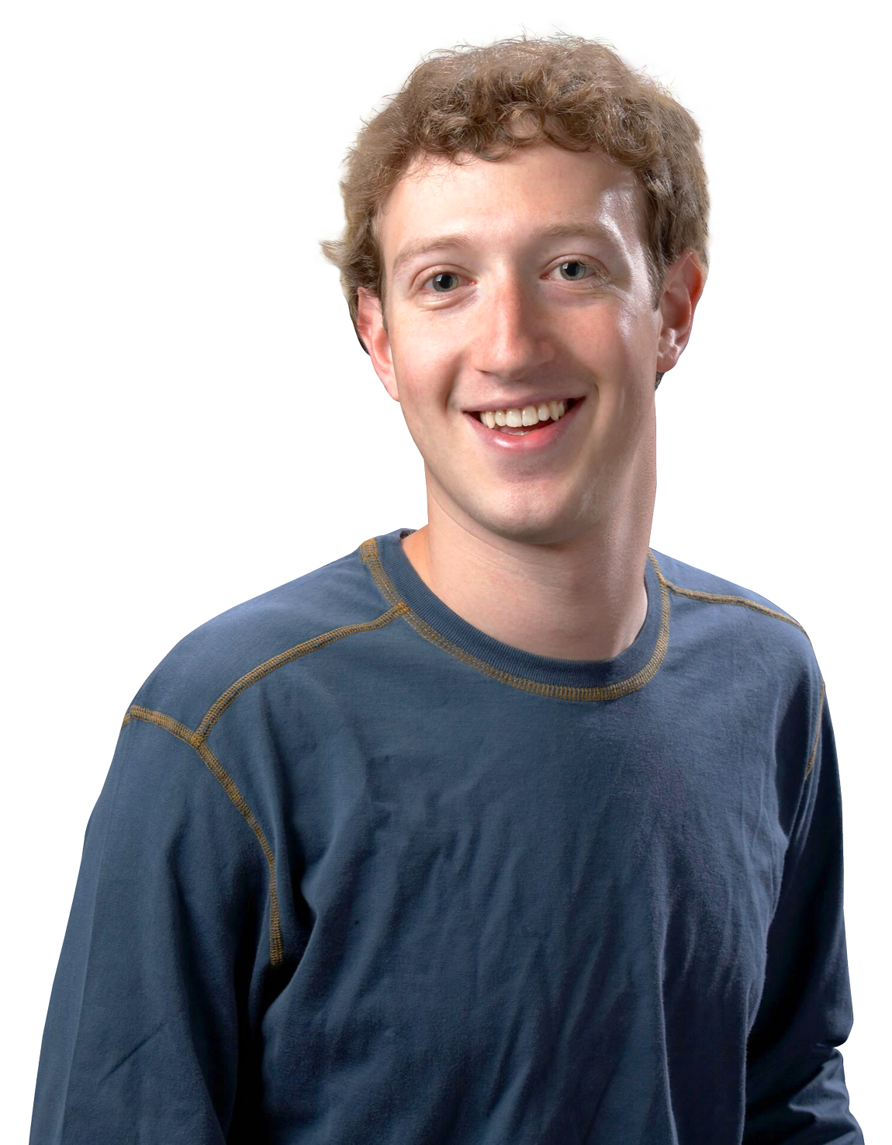
Mark Zuckerberg
Tim Cook
Founder and CEO of Facebook (now Meta Platforms, Inc.).
Zuckerberg created the world's largest social media platform and has since expanded into the realms of virtual reality and augmented reality through Meta. His influence on social connectivity and emerging technologies is indisputable, shaping how we interact online.
CEO of Apple, Inc.
Cook succeeded Steve Jobs as the CEO of Apple and has continued to lead the company's iconic product launches and global expansion. His focus on innovation and sustainability, as seen in Apple's products and supply chain, has made a significant impact on the tech industry.

Slide 12
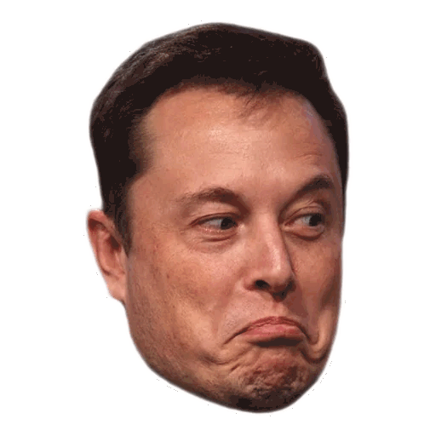
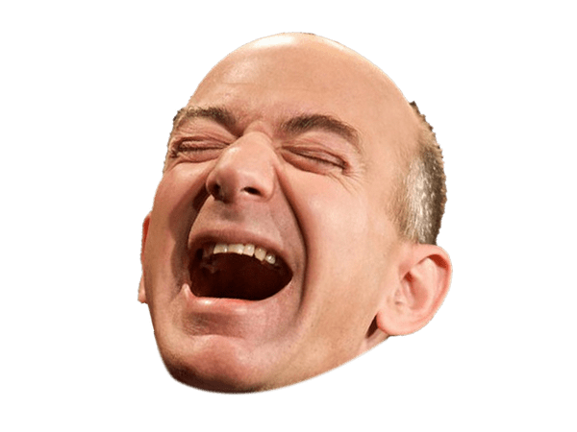
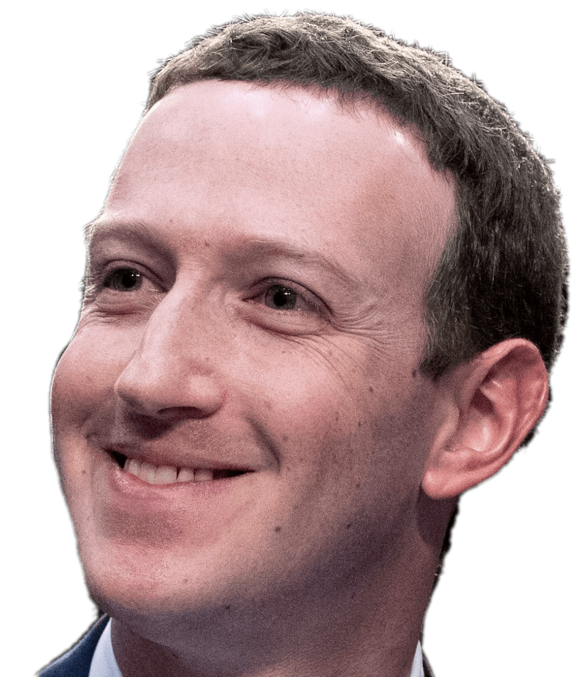
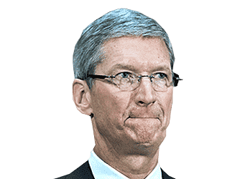
Mark Zuckerberg
Founder and CEO of Facebook (now Meta Platforms, Inc.).
Zuckerberg created the world's largest social media platform and has since expanded into the realms of virtual reality and augmented reality through Meta. His influence on social connectivity and emerging technologies is indisputable, shaping how we interact online.
These individuals have made

Slide 13
These individuals have made

Slide 14
Thank you!
Any questions?

